Slide 1

Underwater Mine Prediction using SONAR Signals data
BY
Nanda kumar Gonuguntla

Slide 2
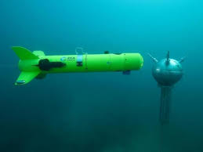
Introduction
Consider there is a war going on between two countries. Attack through water is also main way to destroy opponents army.
Many countries uses ships and submarines in water to attack on other countries. To overcome that the opponent country uses mines which blast when some objects with to contact with it.
To predict that whether the object is mine or rock we used SONAR signal. SONAR signal is nothing but the sound signals emitted by the submarines and receives back.

Slide 3
Problem Statement
In this project, we are ultimately going to design that whether the object is mine or rock using the sonar signal. Here is the process that we are going to implement in the upcoming implementation part.
Sonar Data
Data Pre-processing
Split Train – Test data
Fetch data to machine learning model
Trained model
Input- data
Output – Rock or Mine

Slide 4
Experiment
This experiment was conducted in a lab to collect the data set.
They used metal cylinders in the place of mines and performed the experiment.
We pass the sonar signals and receive back the signals.
Using that that received SONAR signal we perform the experiment.

Slide 5
Available Data Set
This dataset was published in Gorman, R.P., and Sejnowski, T.J. (1988.” Analysis of
Hidden Units in a Layered Network Trained to Classify Sonar Targets”. The dataset is been
collected from UCI Repository. The CSV file contains data regarding sonar signals bounced
off a Mine (M-metal cylinder) and a Rock (R-roughly cylinder rock) at various angles and
under various conditions.
Data set link: https://drive.google.com/file/d/1pQxtljlNVh0DHYg-Ye7dtpDTlFceHVfa/view

Slide 6
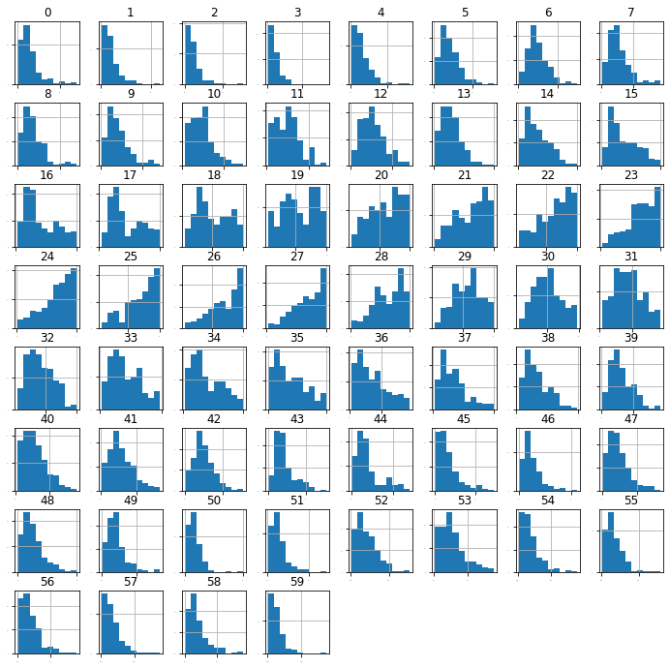
H
I
S
T
O
G
R
A
M
O
F
T
H
E
D
A
T
A

Slide 7
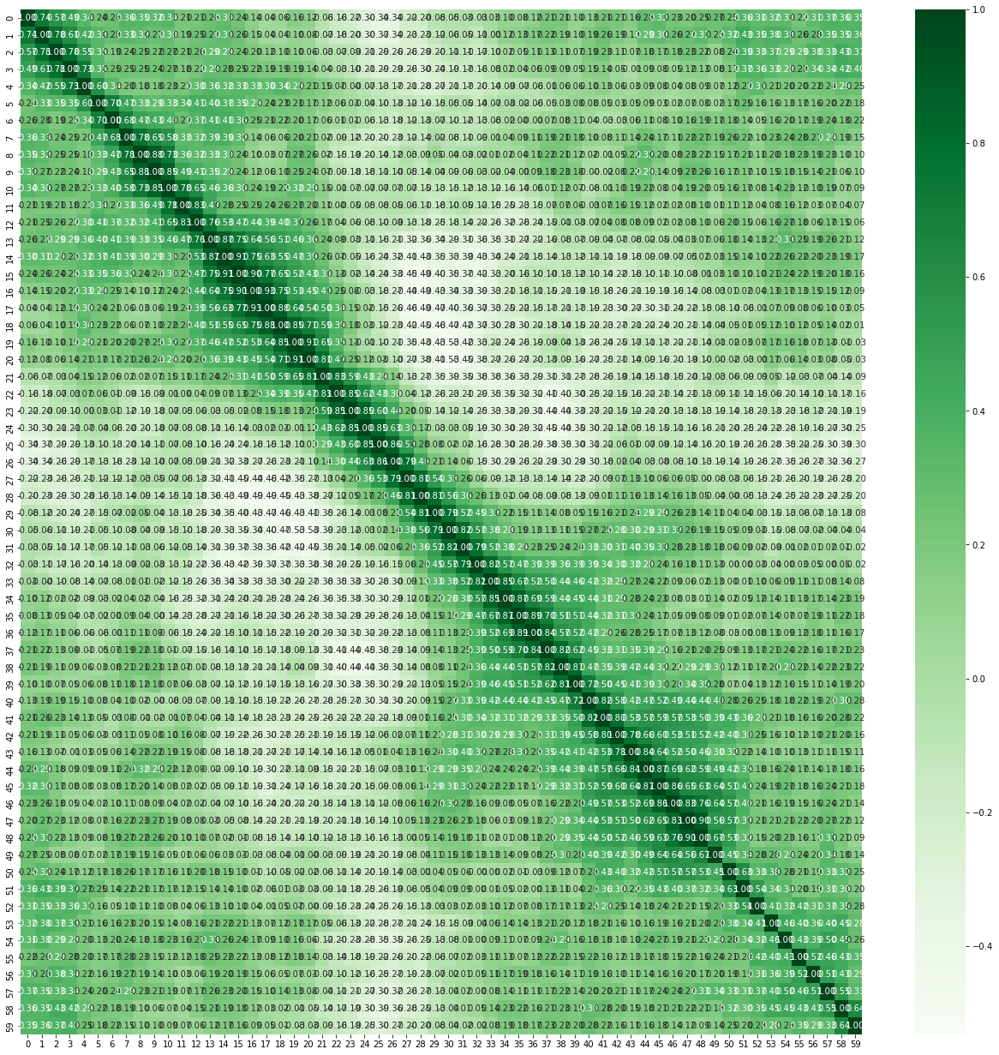
C
O
R
R
E
L
A
T
I
O
N
M
A
T
R
I
X

Slide 8
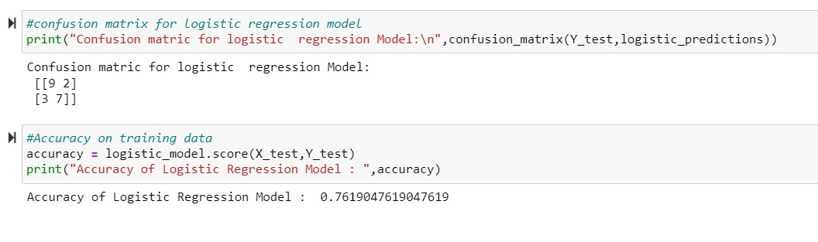
Logistic Regression
It is a Supervised Learning Algorithm. We used the Logistic Regression model to predict the output of the experiment.
Logistic Regression is used in this experiment because it works well for the Binary Classification Model.

Slide 9
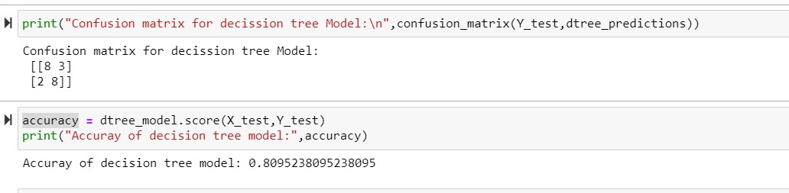
Decision Tree
Decision tree is the most powerful and popular tool for classification and prediction.
A Decision tree is a flowchart like a tree structure, where each internal node denotes a test on an attribute, each branch represents an outcome of the test, and each leaf node holds a class label.

Slide 10
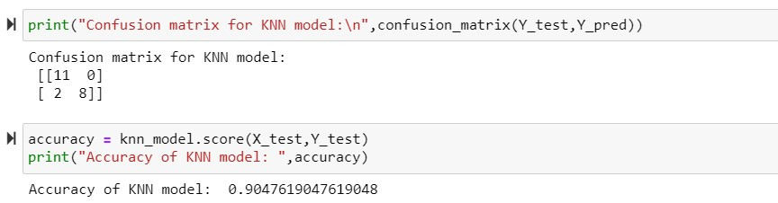
KNN
KNN is one of the simplest Machine Learning algorithms based on the Supervised Learning technique.
K-NN algorithm assumes the similarity between the new case/data and available cases and put the new case into the category that is most similar to the available categories.

Slide 11
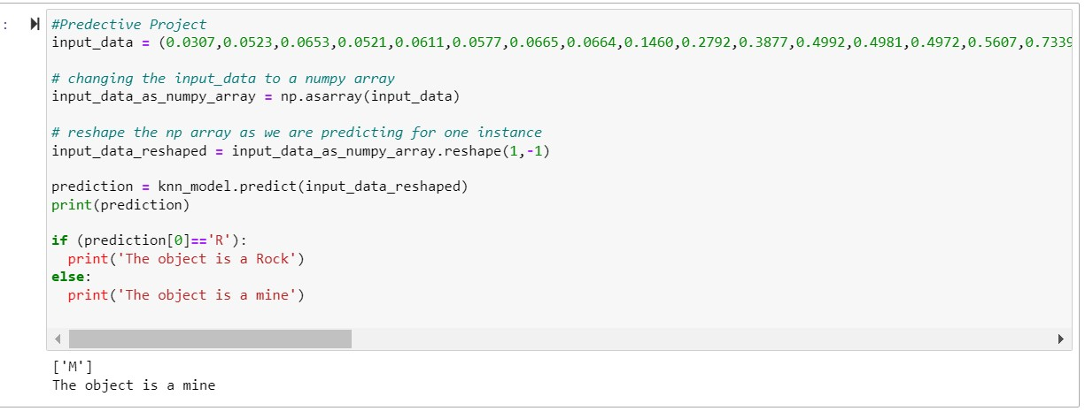
Results
From all the above classification models, we can say that the KNN model has high accuracy in predicting the output.

Slide 12
Conclusion
From this project we can predict whether the object is mine or rock using the input sonar data using a machine learning algorithm.
By using a KNN algorithm model to predict the output using sonar data.
With this model we can predict the output accurately because the accuracy of the KNN model is more accurate compared to other models.

Slide 13
Future work
The first model that was proposed was predicting using the SONAR image. But complications faced by this model lead to the move toward the machine learning model.
The existing model described in this project is dependent upon the Machine Learning Algorithms.
The machine learning algorithm also has a drawback in solving the problem.
The drawbacks of Machine Learning algorithms are the time taken and not being more efficient.
The existing Data set that we used has been experimented with rock as metal cylinder and rock within the laboratory. It is not actual data.
The Proposed method is, to solve this problem using Deep Learning.

Slide 14


